Slide 1
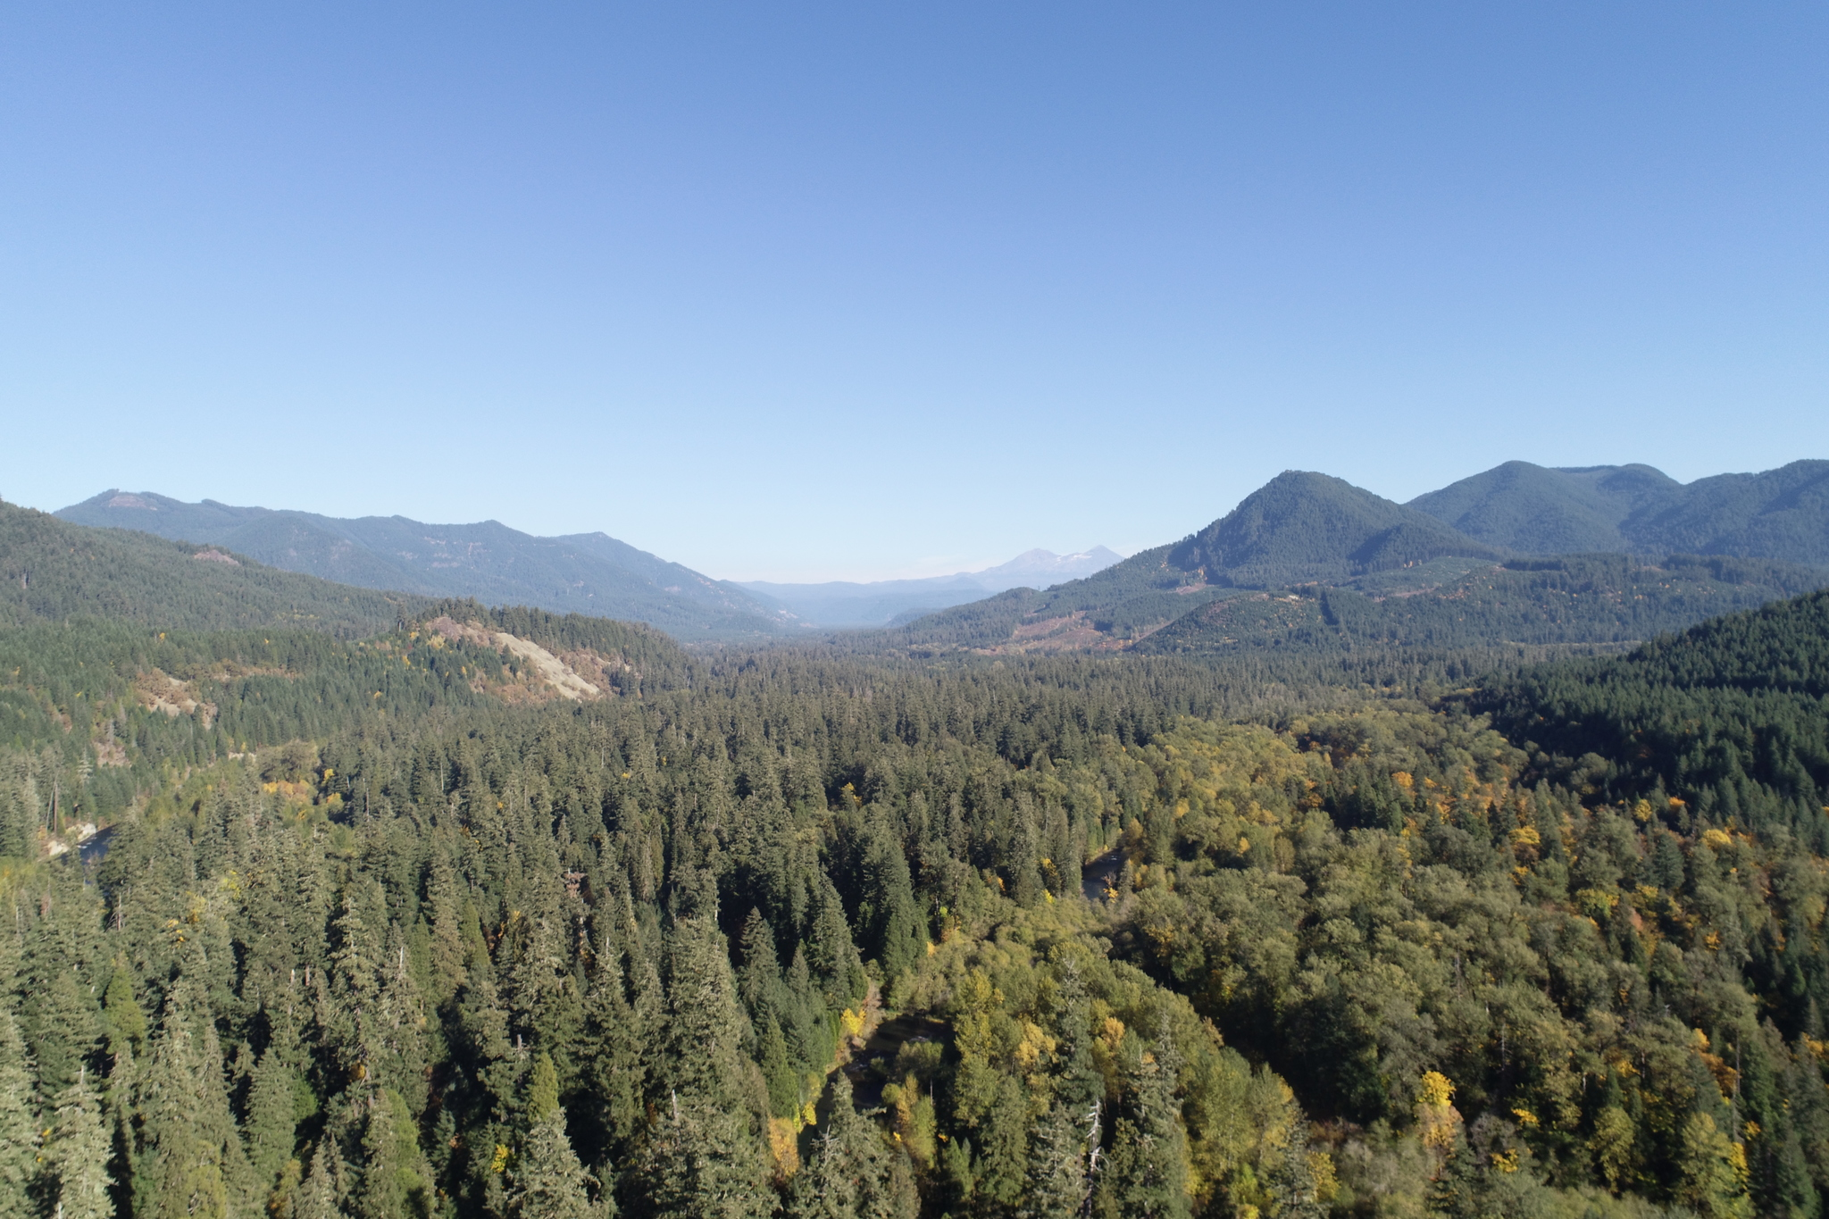
Automatic Methods for Detecting and Quantifying Large Wood Using UAS Imagery

Slide 2
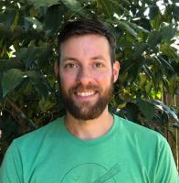
About me
BS Wildlife Conservation and Management University of Nevada, Reno
2nd year MS student Forest Engineering, Resources and Management Oregon State University
Research interests: Remote sensing, GIS, Forest Health, Computer Vision

Slide 3
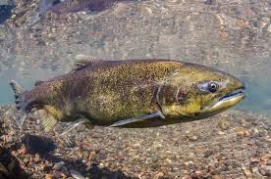
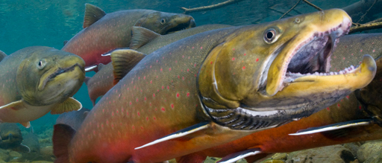
Restoration Project Background
Lower South Fork McKenzie River Floodplain Enhancement Project
~784 acres
Restore complexity to promote biological productivity
Source: https://www.washington.edu/news/2018/02/27/largest-chinook-salmon-disappearing-from-west-coast/
Source: https://www.fws.gov/oregonfwo/articles.cfm?id=149489411
Notes:
1937 surveys, most important tributary for chinook salmon spawning.
Has been altered in the past century, 1963 cougar dam was built leadin to channelization of lower river, large wood removed. This limited sediment and wood supply and reduced complexity of the channel
Looking for retention of 90% of wood in channels over 5 years
Goals: increase sediment storage and diversity/complexity of geomorphic features
Increase substrate size by 25% in wetted channels
Increase diversity of water velocities

Slide 4
Preproject
Source: https://www.mckenziewc.org/?page_id=1608

Slide 5
Postproject
Source: https://www.mckenziewc.org/?page_id=1608

Slide 6
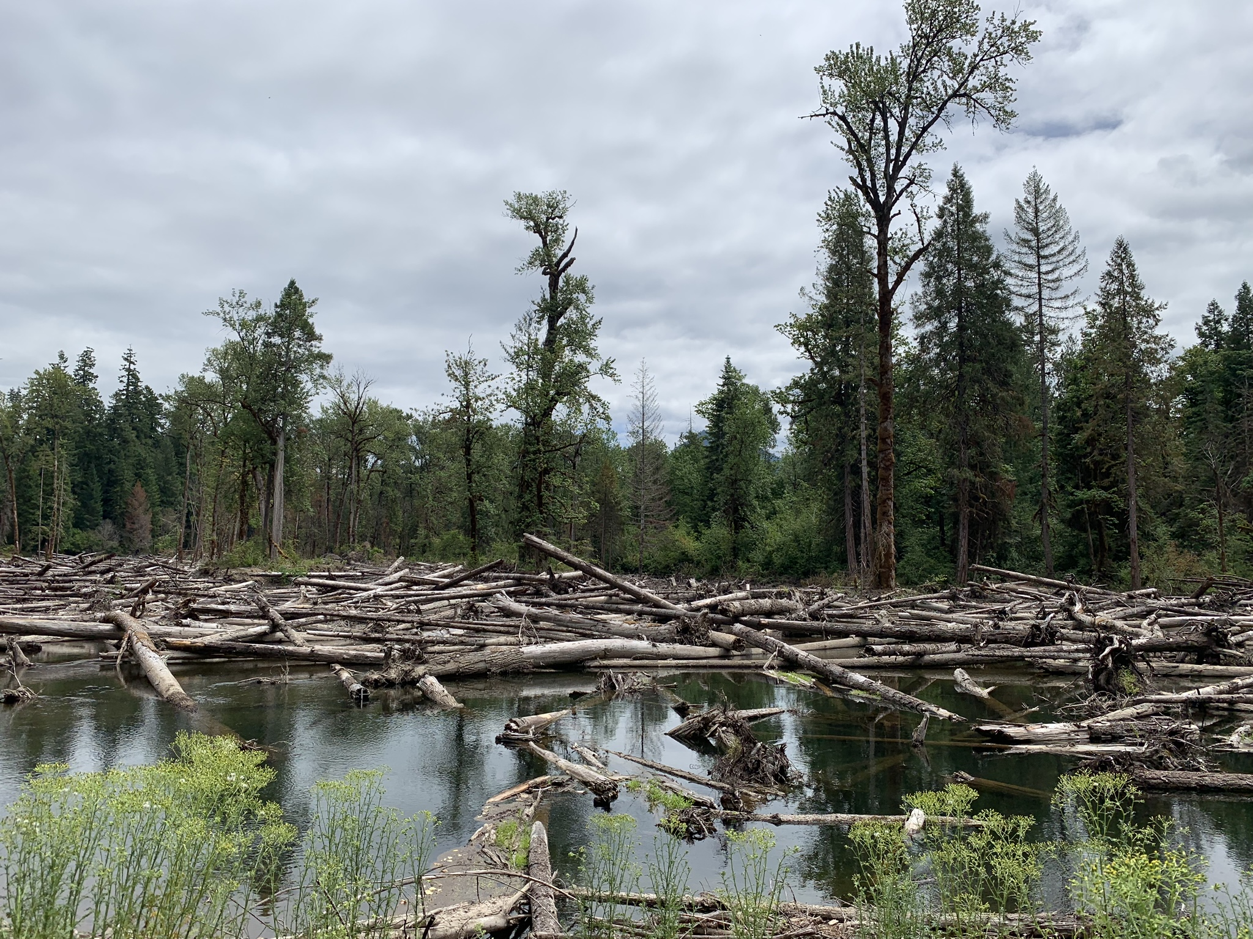
Purpose
Detect and quantify large, woody debris (>25cm) in South Fork McKenzie River
Quantify change detection over time
Is SFMR retaining complexity over time?

Slide 7
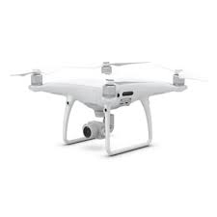
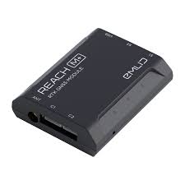
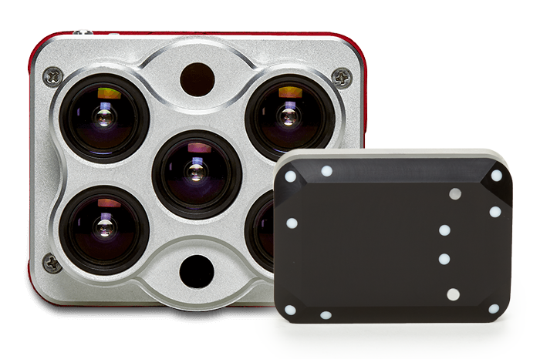
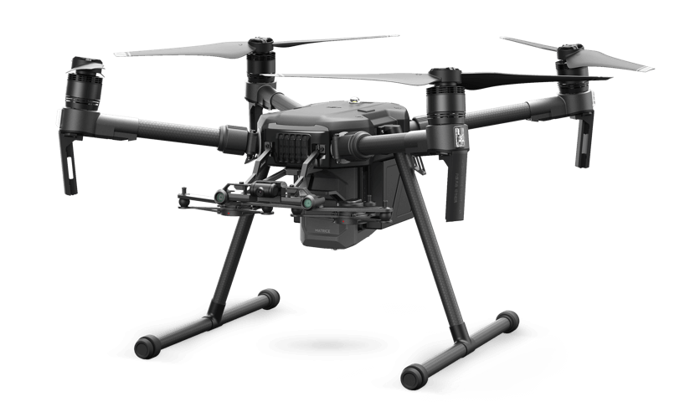
Platform
DJI Phantom 4 Pro
Emlid Reach M+
Micasense Altum
DJI Matrice 200 v2
Source: https://www.micasense.com/altum?gclid=EAIaIQobChMIjtnmiv_R5AIVYiCtBh1dVgXSEAAYASAAEgJ8pvD_BwE
Source: https://www.dji.com/matrice-200-series-v2

Slide 8
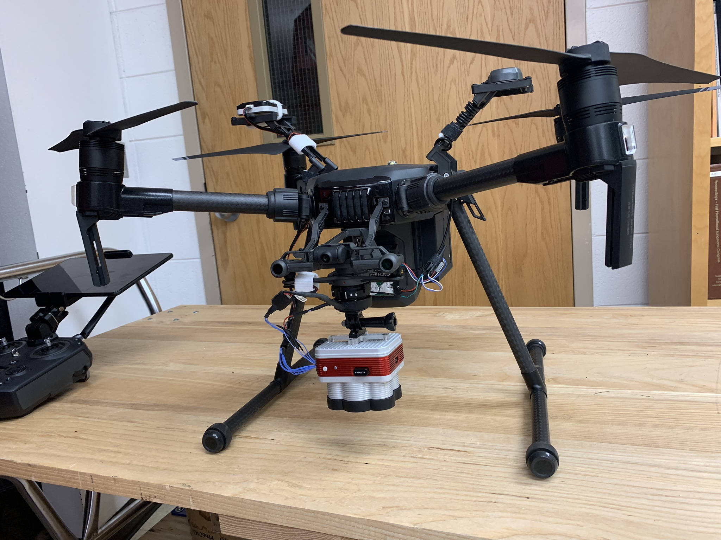
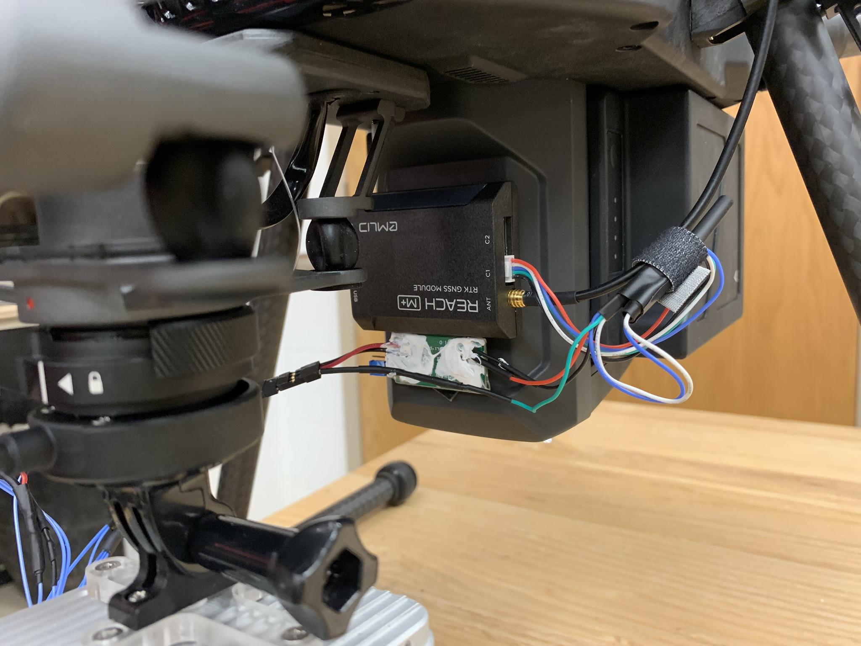
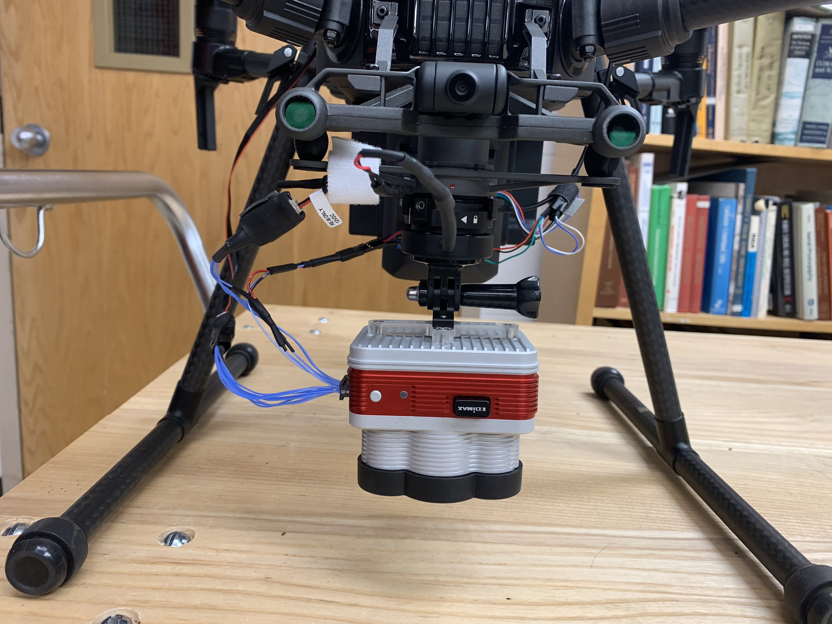
Matrice, Altum , Reach Integration

Slide 9
Mission Planning
Software: UGCS and DJI Pilot app
Things to consider (elevation, highest trees, overlap, desired GSD, LOS, takeoff/landing)
Time of day(solar noon +/- 2.5 hours)
Weather (clouds, rain, wind)
Test your platform!
Develop prefilght checklist (batteries, sensor, chargers, cable, tablet, computer, aircraft, etc.)

Slide 10
Data Management
SSD vs. HDD
Cloud storage

Slide 11
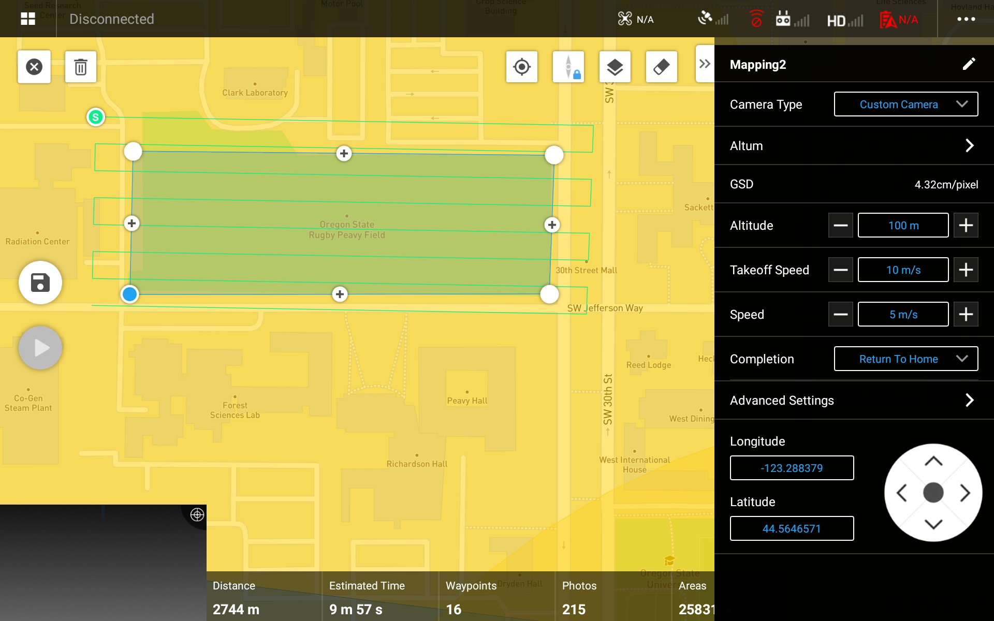
DJI Pilot GUI

Slide 12
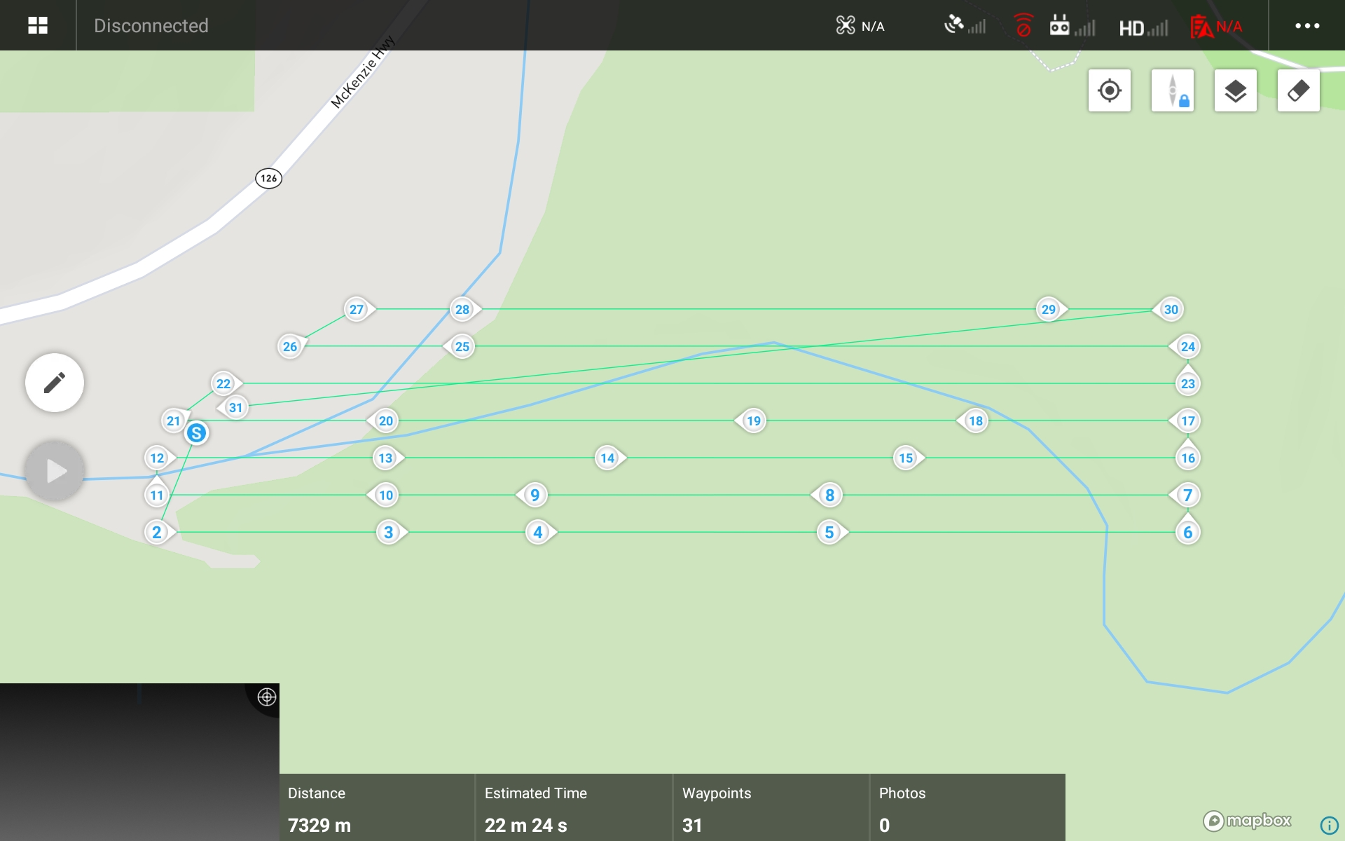
DJI Pilot GUI

Slide 13
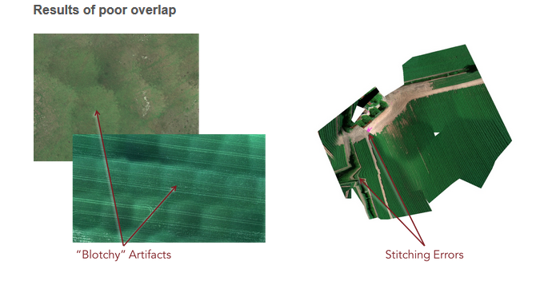
Overlap
Source: https://support.micasense.com/hc/en-us/articles/224893167-Best-practices-Collecting-Data-with-MicaSense-Sensors

Slide 14
Methods
40 ground validation plots
Metrics: large wood (>25cm) diameter, length, hard/softwood
Ground control for georeferencing or emlid reach (PPK)

Slide 15
Processing
Orthomosaic with metashape
Image segmentation with ArcGIS Pro Classification wizard
ArcPy
Notes:
Segmentation – pixels in close proximity with similar characteristics are grouped into a larger segment. Segments with certain shapes, spectral and spatial features are then grouped into objects. These objects can then be classified ie ground cover classes

Slide 16
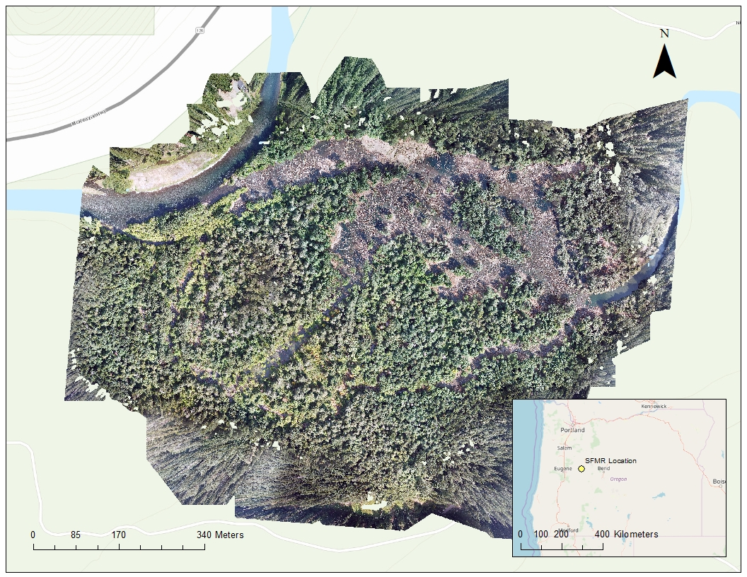
Orthomosaic

Slide 17
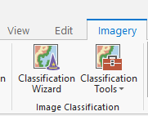
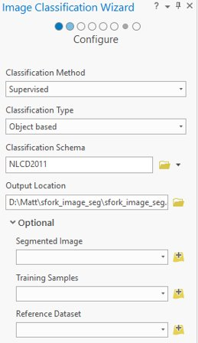
Example Object Detection

Slide 18
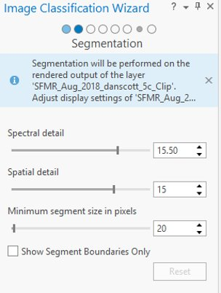
Default segmentation
Notes:
Spectral detail – level of importance given to spectral differences between 1.0-20.0, smaller results in more smoothing
Spatial detail – level of importance given to [roximity between features in the imagery (1-20) higher value is used when features are small and clustered togethere
Lower spatial detail results in more smoothing and less detail
Min segment size in pixels – merge segments smaller than this threshold with the neighbor segment that is most apporpriate.

Slide 19
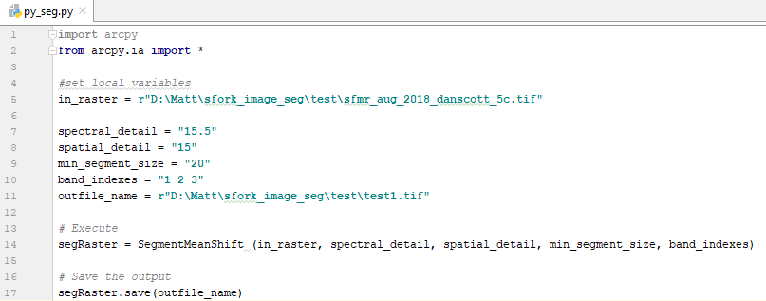
Default segmentation

Slide 20
Default Segmentation

Slide 21
Spatial Detail Slider
GIF built with R "magick"
Notes:
Image1 –4: spatial detail is 15, 10, 5, and 1

Slide 22
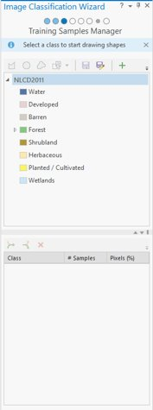
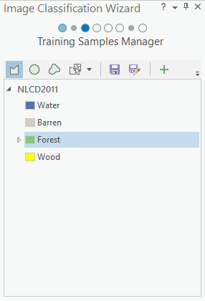
Training Samples

Slide 23
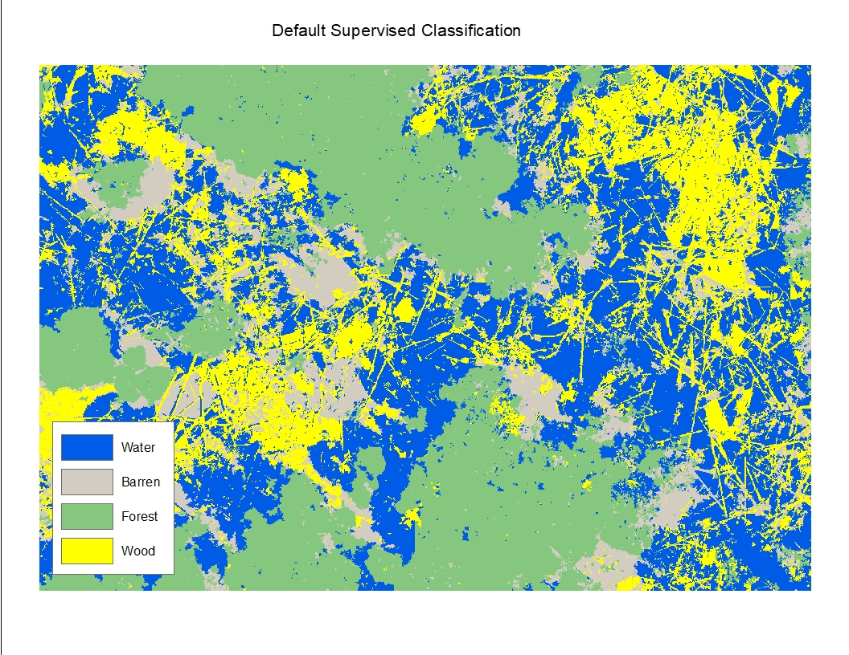
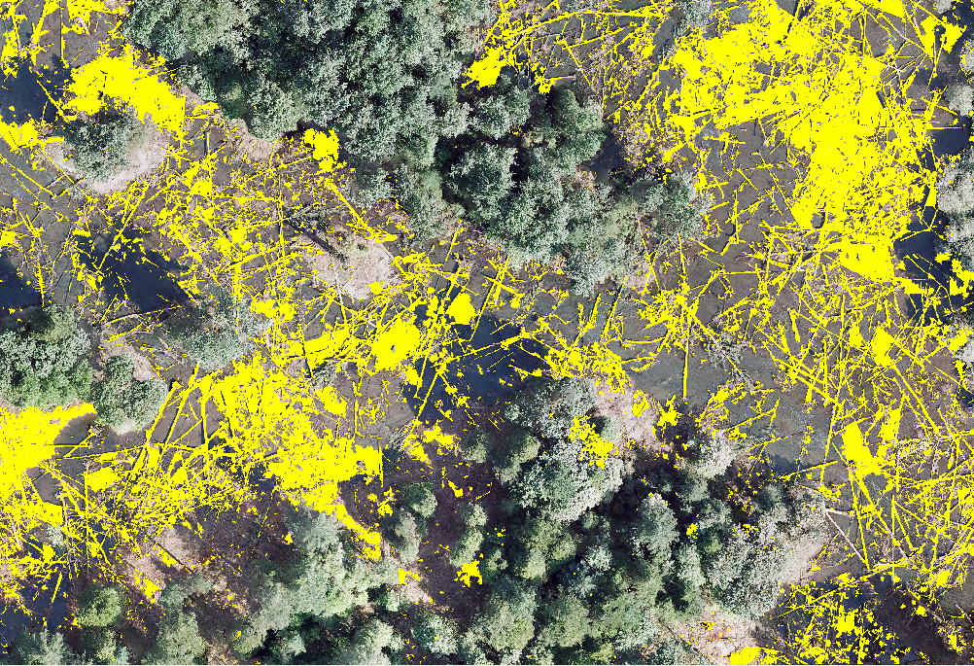
Classified Imagery

Slide 24
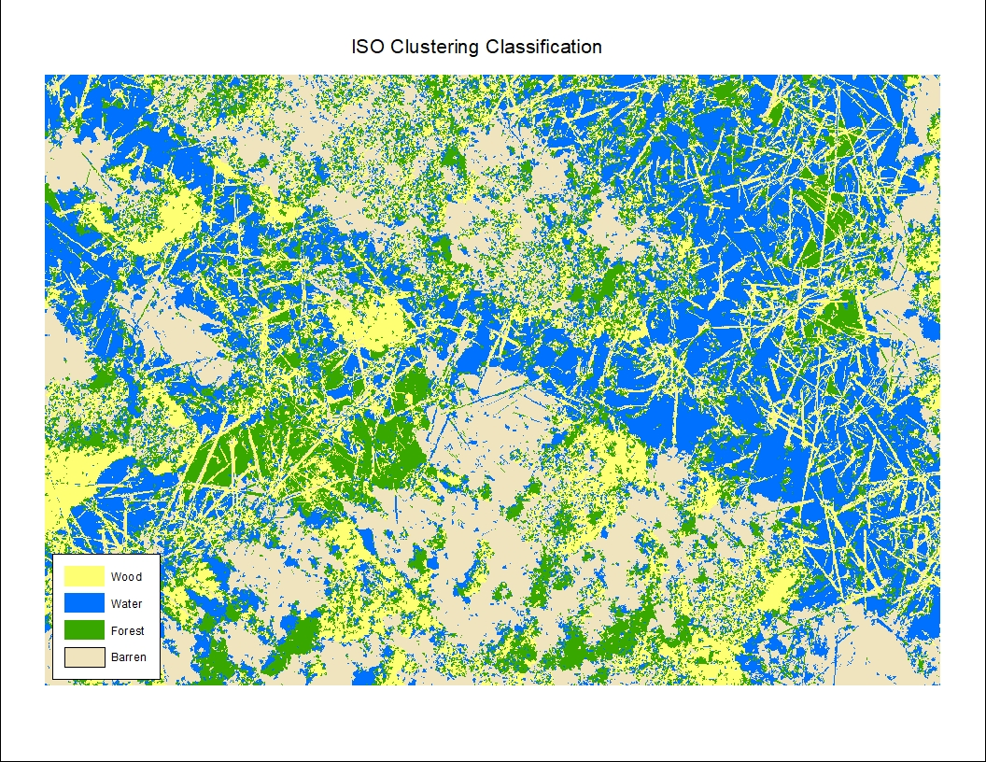
ISO Cluster classification
Notes:
Unsupervised classification that does not take into account training samples. Pixels or segments assigned to classes based on spectral and spatial statistics.

Slide 25
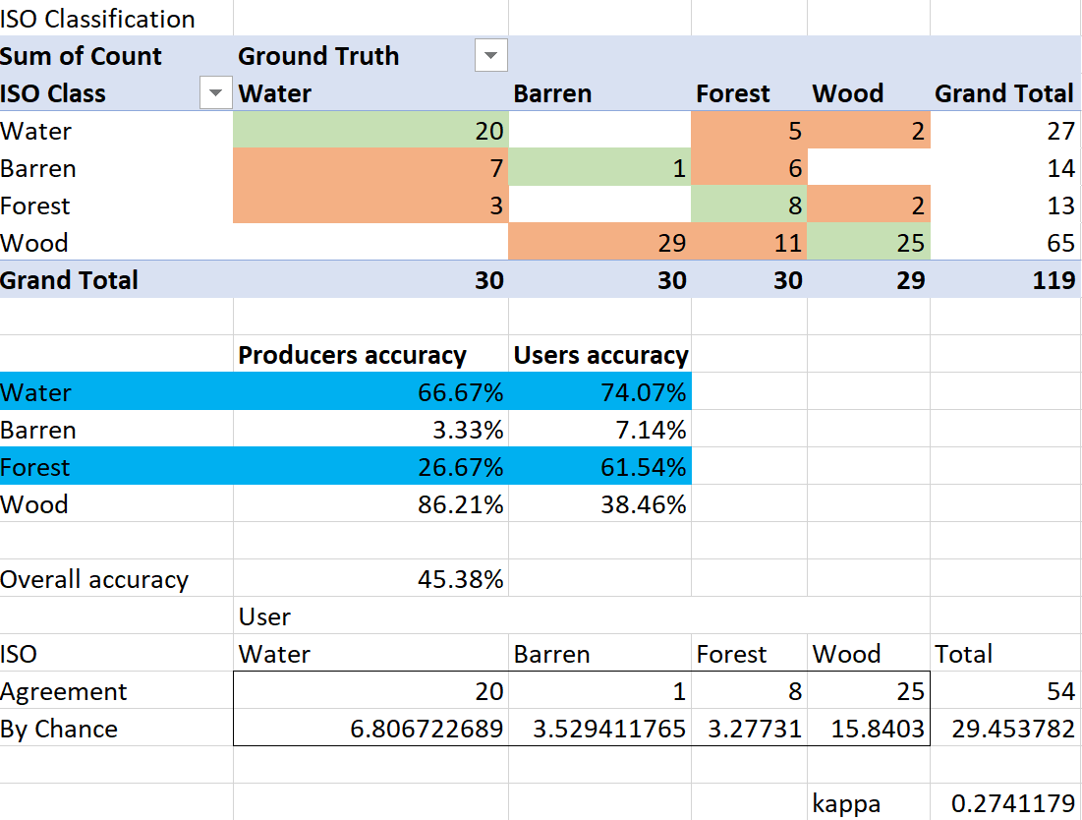
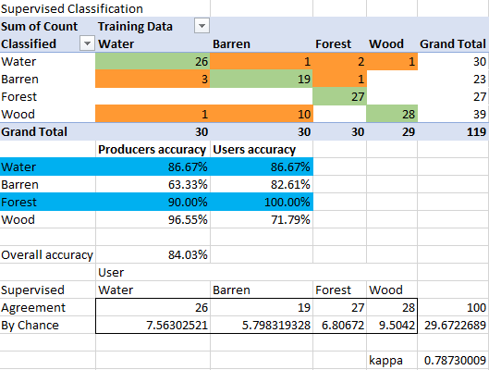
Evaluating classification
Notes:
KIA is proportion of agreement after removing random effects
According to Landis and Koch (1977) <.2 is poor, .21 to .40 is fair, .41 to .60 is moderate, .61 to .80 is good, and .81 to 1 is very good

Slide 26
Future
Trimble eCognition
Deep learning (tensorflow, keras, arcgis pro)
Redo classification with NDVI and DSM as inputs
Notes:
Ecog – used for object-based image analysis, user develops rule sets for automatic analysis.

Slide 27
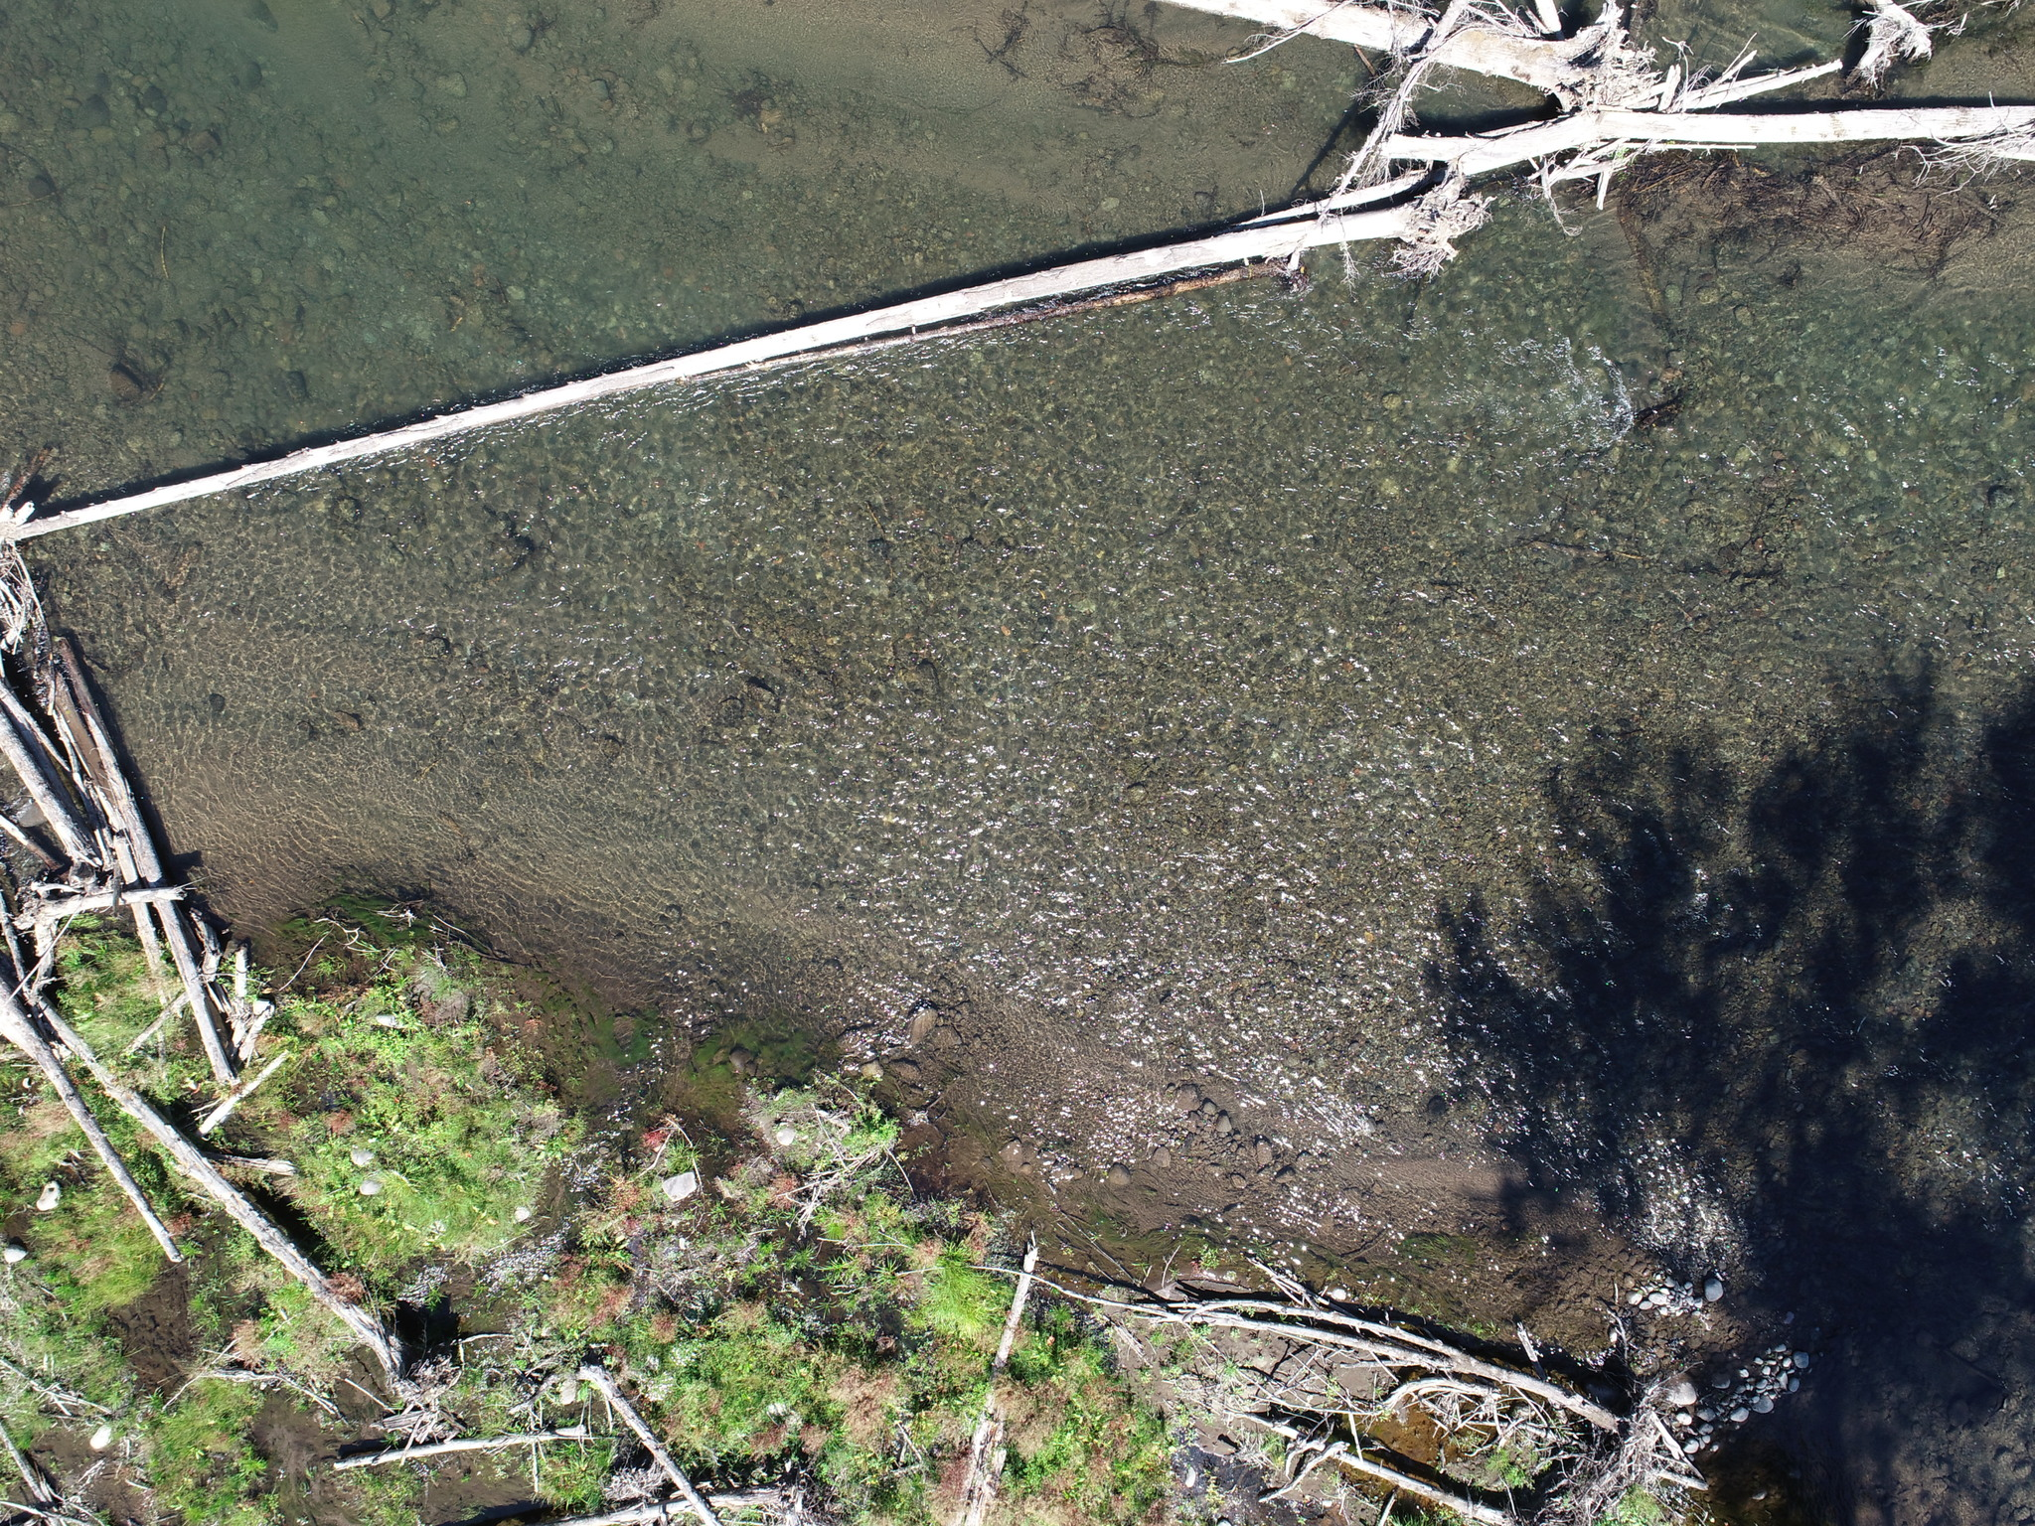
Photoplots
Notes:
Field techs took 3 weeks to gather metrics in 40 photo plots
Drone gathered more than half in 1 hour total flight time
Will attempt to gather sediment and velocity data from plots
Techs gathered 10 sediment samples for size in mm, velocity at surface and 60% depth, measured water depth where velocity was taken

Slide 28
Photoplots

Slide 29
Velocity from video

Slide 30
What we've learned
UAS surveys site in fraction of time
Emlid reach integration will save time vs. Ground control
Find mission planner that suits your needs
Attend events, register for workshops

Slide 31
Useful Links
ArcGIS Segment Mean Shift Image Analyst Tool
SFMR Floodplain Enhancement Project
DJI Matrice 200
Micasense Altum
ESRI
Agisoft MetaShape
Best Practices from Micasense
UgCS
USGS Earth Explorer
Part 107 Practice Tests
Landis, J. R., & Koch, G. G. (1977). The Measurement of Observer Agreement for Categorical Data. Biometrics, 33(1), 159-174.

Slide 32
Contact info
AIS Lab
http://ais.forestry.oregonstate.edu/
Matt Barker
matthew.barker@oregonstate.edu

